Slide 1

Using Neural Networks to Classify Alphabetic Characters
By David Melanson

Slide 2
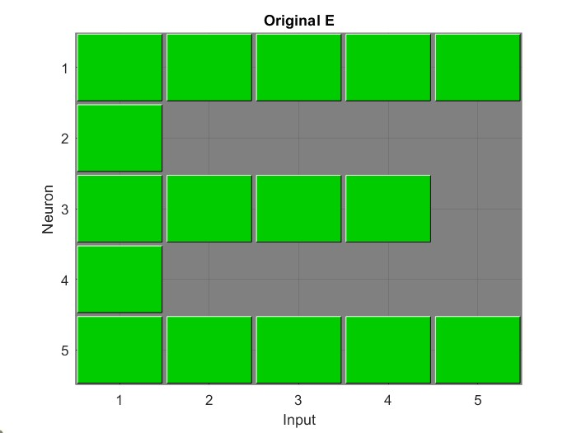
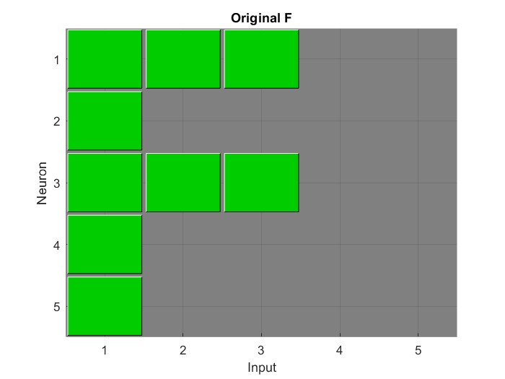
Training Data

Slide 3
Premise:
Perceptron and HEBB are trained with a sequence of 25 bits and tested against the same set with random bits being flipped. Perceptron has binary input and output, so flipping bits means going from 0 to 1 or vice versa. HEBB has bipolar inputs, so it goes from 1 to -1 or vice versa.
Each network is tested against randomized sets of 10,000 bit sequences with 1 to 20 bits being flipped from the original training data.

Slide 4
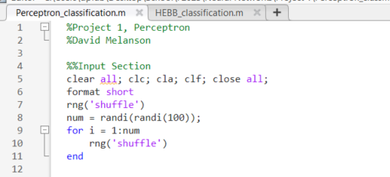
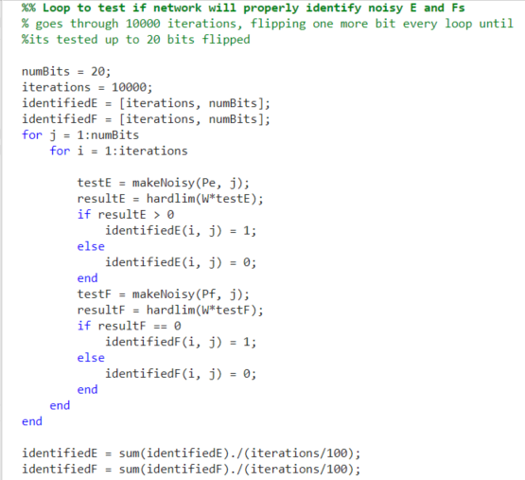
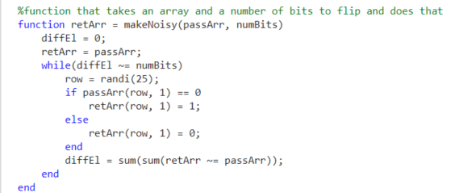
Implementation

Slide 5

HEBB Testing and Data Sets

Slide 6
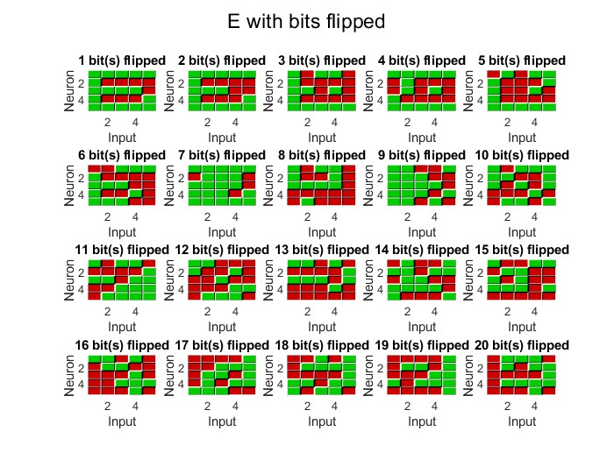
Example Test Data for Hebb ‘E’
Bipolar input
Green represents 1
Red represents -1

Slide 7
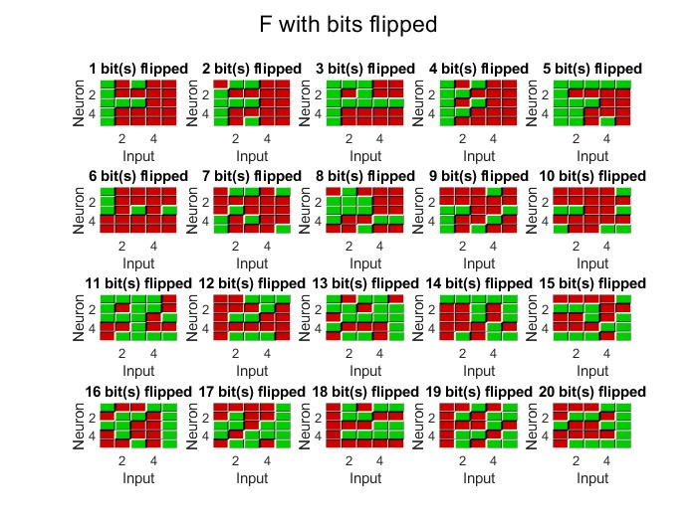
Example Test Data for Letter ‘F’
Flipping a bit in this case means switching it from 1 to -1 or vice versa.

Slide 8
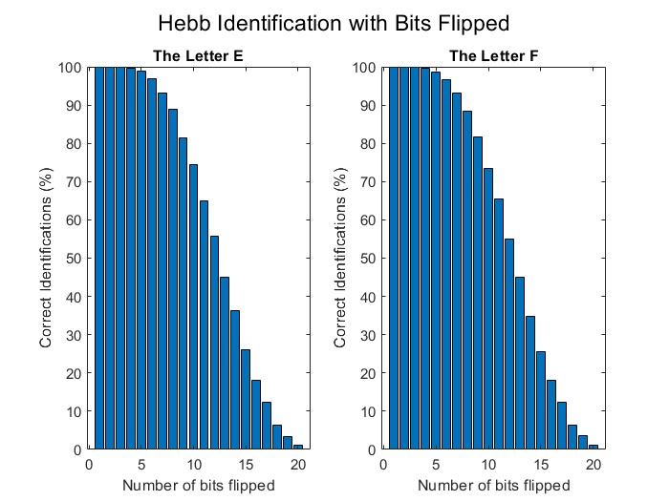
Successful Identification
Steep drop after 10 difference of 10 bits.
By 20, around 1% identification rate.
Consistent between both E and F.

Slide 9
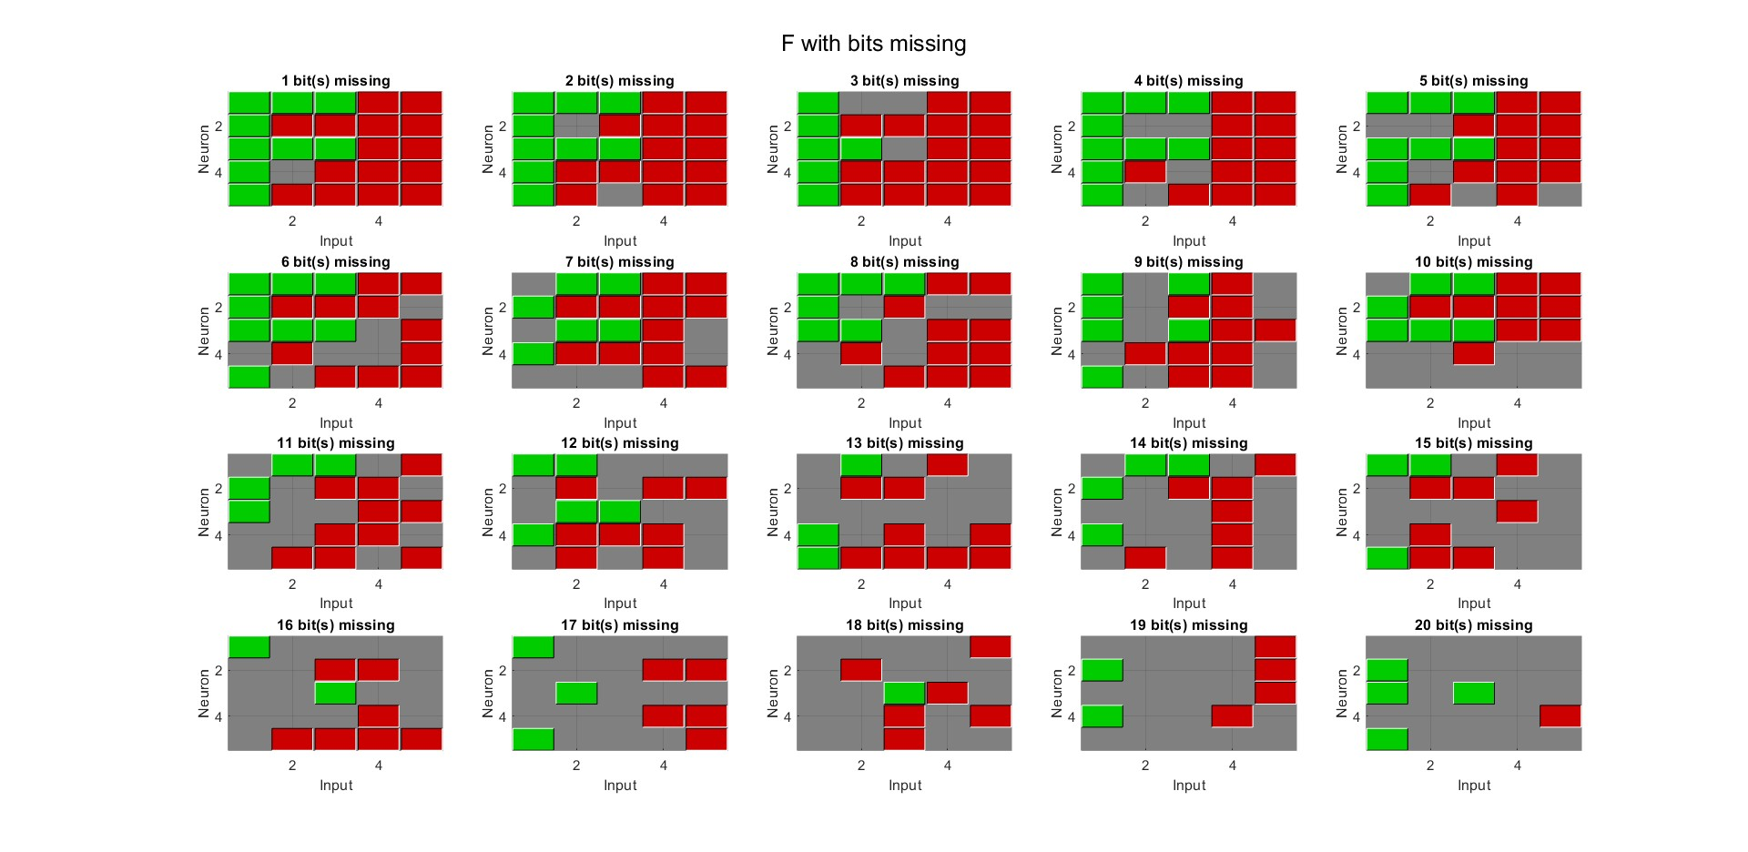
Example Test Data of F with Missing Bits

Slide 10
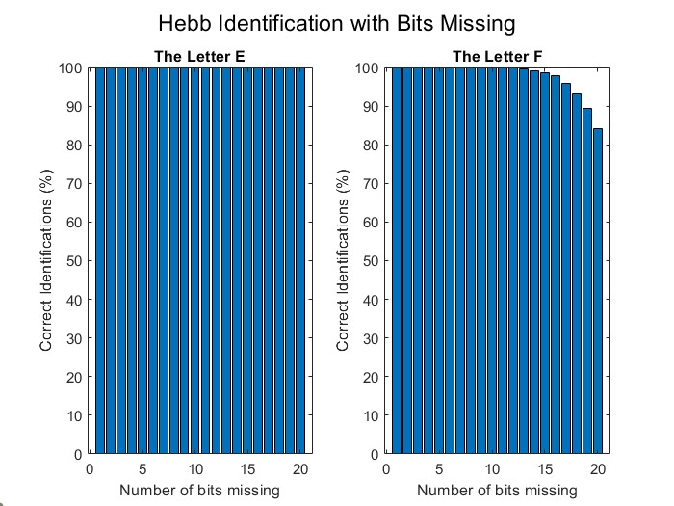
Results with Missing Data
Missing data in this case means switching bits from 1 or -1 to 0.
HEBB did better with ‘missing’ data, it gave it less room for error.

Slide 11
Perceptron Testing and Data Sets

Slide 12
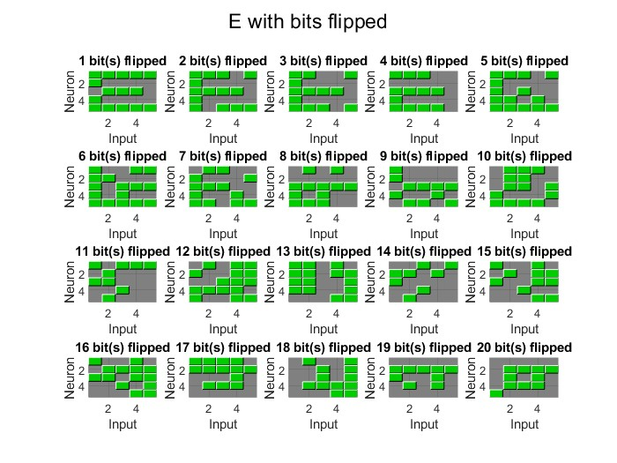
Example Test Data of E with Flipped Bits

Slide 13
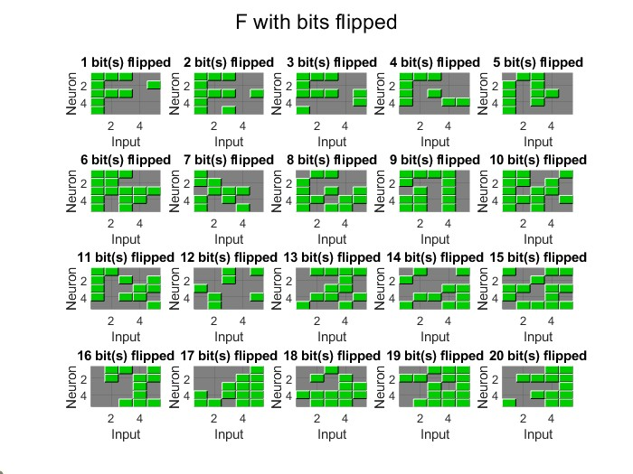
Example Test Data of F with Flipped Bits

Slide 14
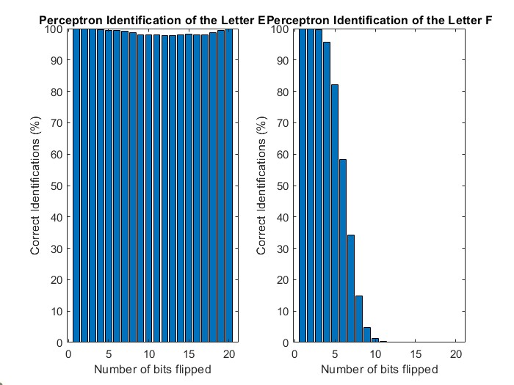
Successful Identification
Perceptron classifies things well until 5 bits are changed.
At 6, correct F classifications drop from ~81% to ~51%.
From this point, the network biases to classifying everything as E.

Slide 15
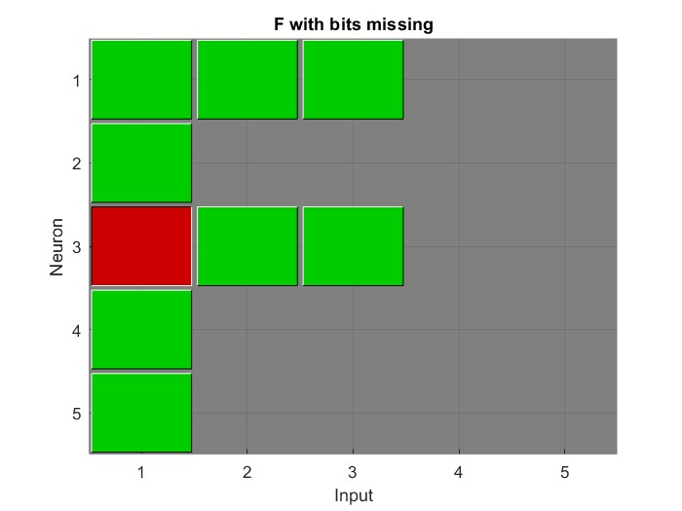
Example Test Data of F with Missing Bits
Unlike HEBB, Perceptron didn’t know how to handle this and never came to a solution.

Slide 16

Thanks for Listening!

